Slide 1
Interpreting evidence from real world data
A/Prof Chris Oldmeadow
BCT Trainee and Early Career Weekend
July 2024

Slide 2
Presentation overview
The RCT and Problems with RCT
Real World evidence
Causal modelling with observational data
The target trial framework
Touch on some statistical concepts (propensity matching)

Slide 3
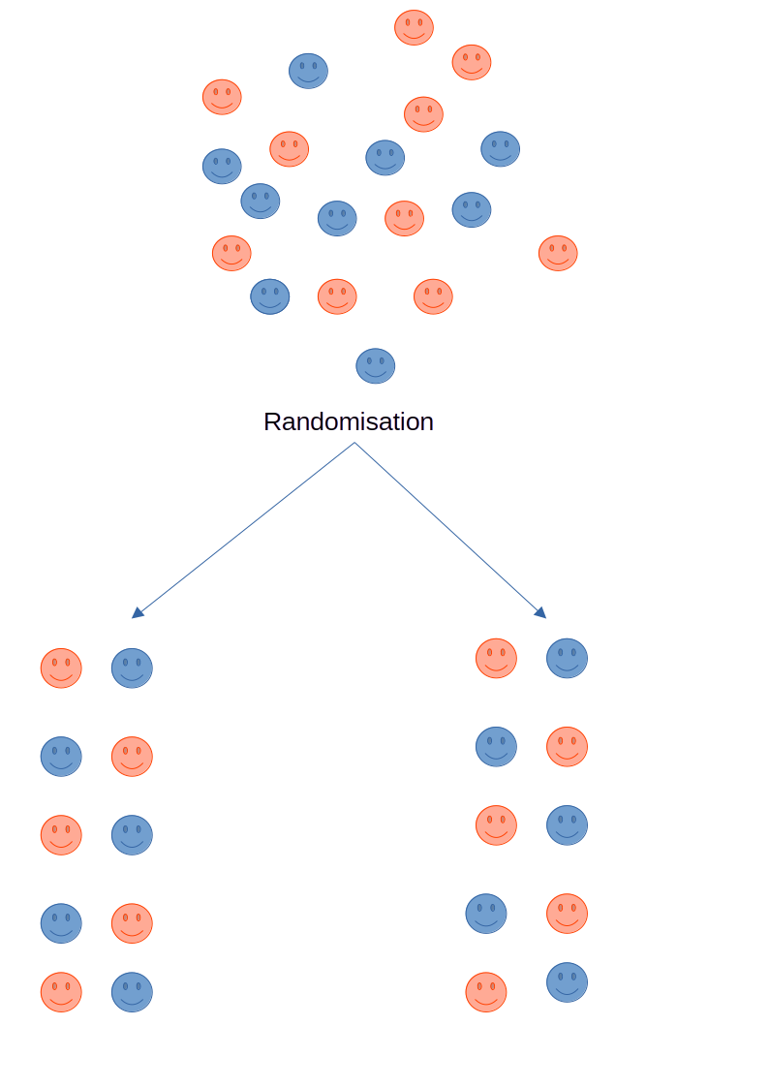
The RCT
Problems:
Expensive
Long duration
Not always possible
External validity
Notes:
RCTs have a number of practical limitations, including the need to prospectively recruit and monitor study participants, often in large numbers in highly controlled processes that are costly, cumbersome and time-consuming
Clinical trial participants are highly selected and may not be representative of the broader patient population,
Older patients aged 65 years and above are consistently under-represented in clinical trials
under-representation of patients from racial and ethnic minorities, those with socioeconomic disadvantage, and patients with complex health problems;
Patient care provided in clinical trials does not necessarily represent routine clinical practice

Slide 4
What is Real-World Evidence?
FDA definition “healthcare information derived from multiple sources outside of typical clinical research settings, including electronic medical records (EMRs), claims and billing data, product and disease registries, and data gathered by personal devices and health applications”
Offers a chance to identify and address gaps in clinical trial evidence
Notes:
RCTs have a number of practical limitations, including the need to prospectively recruit and monitor study participants, often in large numbers in highly controlled processes that are costly, cumbersome and time-consuming
Clinical trial participants are highly selected and may not be representative of the broader patient population,
Older patients aged 65 years and above are consistently under-represented in clinical trials
under-representation of patients from racial and ethnic minorities, those with socioeconomic disadvantage, and patients with complex health problems;
Patient care provided in clinical trials does not necessarily represent routine clinical practice

Slide 5
Real World Data
EMR (structured and unstructured clinical data reports, imaging, pathology, detailed treatment information)
Administrative datasets
Eg Admitted Patient Data collection (Patient admission and discharge date, diagnostic codes, procedures), Emergency Department Data Collection
not designed for research
important clinical details (eg performance status, comorbidity, data on treatment including rational as well as key pathological features) are
frequently poorly documented
Cancer registries
Richer data sets
state-level registries only offer a core minimum dataset, have missing data, completeness of variables and timelines
multi-disciplinary,Multi-site national/international registries: more granular level data
Linked data sets
The Enduring Cancer Data Linkage (CanDLe)
Cohort 1 (~1.5 Million): People with a cancer diagnosis, NSW+ACT cancer registries
Cohort 2 (~4 million): Women who have a screening record in Breast Screen NSW, NSW Pap test register, Cervical
LUMOS: Primary care data linked with hospitalisations and ED, cancer registries,
Integrated care, RBDM

Slide 6
What can we do with Real-world data
Comparative effectiveness
Assess variation in care
Biomarker/translational research (when registry linked with biospecimen data)
generate evidence on rare outcomes. long-term or unexpected toxicities
Extending inferences from RCT to real-world

Slide 7
Limitations of Real World Data
Data availability and quality
Confounding due to no randomisation

Slide 8
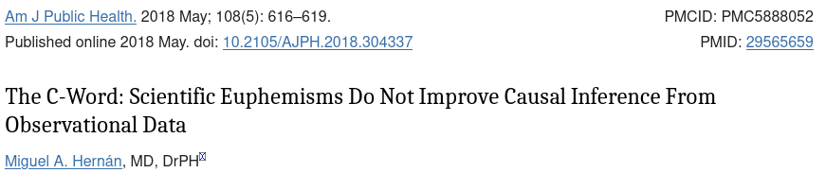
Observational data and the “C-word”
“Dear author: Your observational study cannot prove causation.
Please replace all references to causal effects by references
to associations.”

Slide 9
The Target Trial framework
Plan analysis as though your data are from a hypothetical trial, defining:
Eligibility criteria
Time zero
Treatment strategy clear definition
Assignment procedure
Follow-up period
Outcome
Causal contrast (eg ITT effect)
Analysis plan

Slide 10
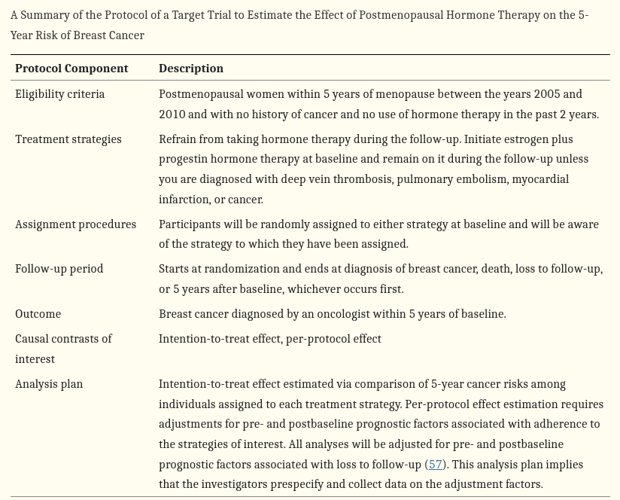
Example

Slide 11
Minimising the effect of confounders
DAGs are useful tool for considering confounders
“Draw your assumptions before your conclusions”
forces the research team to carefully think through the
confounding variables and their interrelationships

Slide 12
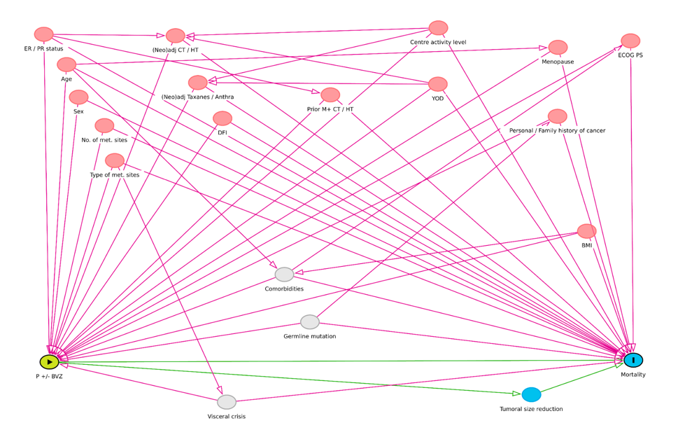
Combination of PBVZ prolonged progression-free survival (PFS) as compared with paclitaxel alone (median PFS = 11.8 vs 5.9 months; hazard ratio [HR] = 0.60; P<.001
Antoine A, et al. Target trial emulation to assess real-world efficacy in the Epidemiological Strategy and Medical Economics metastatic breast cancer cohort. J Natl Cancer Inst. 2023 Aug 8;115(8):971-980..

Slide 13
Confounder control
Want a balanced covariate distribution between treated and
untreated groups.
Propensity scores: probability of receiving a treatment
conditional on confounders
“Given two people with the same probability of receiving treatment,
but one person actually received treatment
what is the difference in their outcomes”
Matching
Weighting (IPTW)

Slide 14
Propensity matching
create a “matched population” where the treated and untreated are
exchangeable
eg for every treated person, find an untreated person that was similar
in every other way bit was not treated
Propensity scores allow is to determine similarity
Propensity score is prob of treatment
For each treated individual find a untreated individual with a similar
propensity score

Slide 15
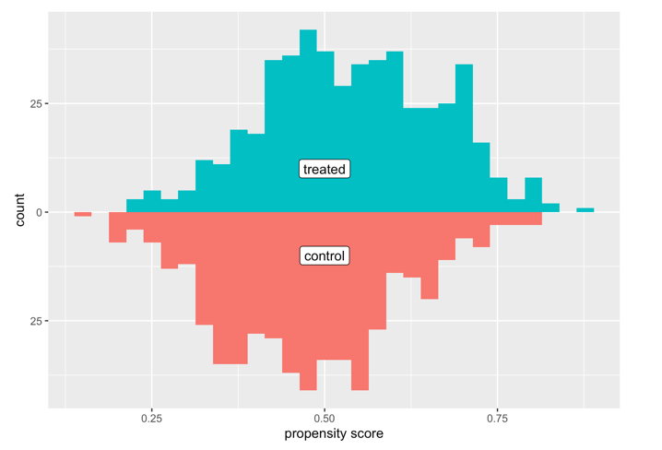
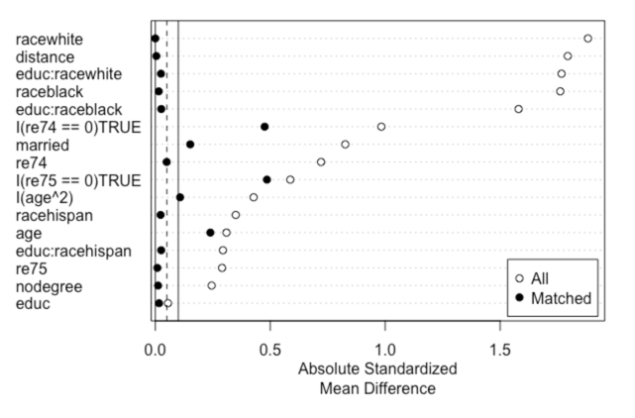
How well did we balance the confounders
Overlap in propensity scores

Slide 16
What about umeasured confounders??
Should perform a sensitivity analysis
How robust are the results/conclusions to possible un-measured confounders
The E-value - How big a relative risk (between exposure and confounder)
would need be to nullify an effect
If bigger than any of the measured ones then that means unlikely
If small then casts doubt on the results

Slide 17
Conclusions
We can talk about causal effects from real world data
There are many great local resources
Should use the target trial framework
More advanced methods for controlling confounders
Need sensitivity analyses

